Slide 1
U.S. Treasury E-Commerce Strategies and Solutions
Joint Financial Management Improvement Program (JFMIP)
Tamara Whitaker, Revenue Collections Management
Adam Martin, Payment Management
May 9, 2016

Slide 2
Agenda
Mission and Vision
Digital Wallets
Non Traditional Alternative Payments
Online Bill Payment
Mobile Program
Direct Express
BuySecure

Slide 3


Bureau of the Fiscal Service
To promote the financial integrity and operational efficiency of the federal government through exceptional accounting, financing, collections, payments and shared services.
To transform financial management and the delivery of shared services in the federal government.
Responsible for 1.16B payments totaling $2.6T in FY’15
Responsible for 508M transactions totaling $3.9T collected in FY’15
Notes:
This slide highlights both the mission and vision statements from our Payments and Collections areas with the Fiscal Service as well as key statistics from Fiscal Year 2014

Slide 4

DIGITAL WALLETS
Convenient, Simple, Secure

Slide 5




Digital Wallets: Choice in Payments and Collections
DIGITAL WALLETS offer convenient, secure, and sometimes anonymous, ways to make electronic payments and collections
Payments and Collections
Collections only
Collections only

Slide 6
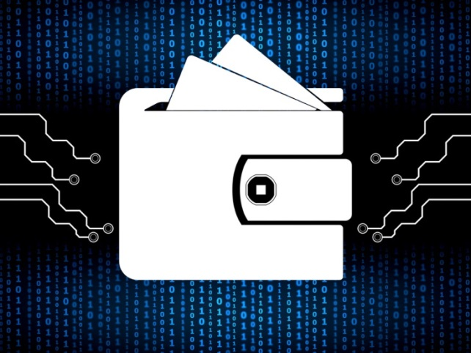
Benefits of Digital Wallets
What are Digital Wallets and what do they do?
Digital wallet payments provide government agency customers with simple, convenient, and secure ways to pay the government.
What are the BENEFITS?
Simple, convenient and secure payment options
Provides consumer anonymity
Reduces exposure of citizen PII
Extends payment to International users
No change in current reporting
Quick time-to-implement
Provides customers more choice in payments
Now accepted via Pay.gov

Slide 7
PayPal
PayPal accounts are easy to establish
PayPal has more than 176 Million active accounts across 203 countries and markets and can hold balances in 26 currencies
Over 7 Million merchants accept PayPal
PayPal gives people a simple way to pay agencies without sharing financial information, with the flexibility to pay using their account balances, bank accounts, or credit cards
PayPal processes more than 12.5 Million payments every day
.
Notes:
In 2014, 20% of PayPal’s net Total Payment Volume was from mobile payments.

Slide 8

Dwolla
Founded in 2008
Offers another digital wallet alternative for citizens who may not want to provide their credit card information to government
It saves government (and ultimately, taxpayers) a substantial amount in transaction costs
Created its own end-to-end, open loop payment network for anything connected to the Internet
As of May 2015, it had more than 650,000 users and had transferred as much as $5 million per day.¹
¹Consumer Finance Protection Bureau, March 2016
Notes:
Dwolla’s transaction limit is normally $10,000/transaction, but RCM can request an increase up to $50 million
Partnered with the state of Iowa in January 2013.
Free solution.

Slide 9
Amazon Payments
A way for customers to make payments or purchase goods and services from US based websites using the payment methods stored within an Amazon.com account
Parent company is Amazon.com
Method of payment options include credit/debit card
Currently being integrated into the Pay.gov platform
Launched in 2007

Slide 10
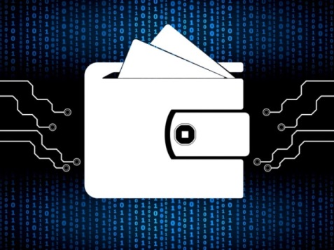
Digital Wallets: By The Numbers
Collections
As of 3/31/16: 61 agencies, 33,829 transactions for $66,352,667
Payments (still in pilot mode)
As of 3/31/16: 207 payments made for $246,820

Slide 11
Non Traditional Alternative Payments (NTAP) Introduction/Background
While Treasury’s All Electronic Initiative successfully increased the EFT percentage for beneficiary payments, our efforts to match the success for all other types of payments have languished.
The continued use of paper checks by agencies not only validates the uniqueness of these payments types but demonstrates that use of the traditional electronic payment methods (ACH, Wire) does not provide the utility of aftermath processing, ease of use, flexibility, or universal-acceptance.
Treasury’s NTAP initiative is a way for recipients to receive Federal payments by only providing an email or mobile phone number.

Slide 12
Fiscal Year 2014-2015 Payments Snapshot
FY ’14 EFT %
Benefit payments: 97.7 %
Vendor payments: 73.1%
Miscellaneous payments: 91.2%
Tax refund payments: 72.3%
Total payments: 94.4%
FY ‘15 EFT %
Benefit payments: 98.0 %
Vendor payments: 77.5%
Miscellaneous payments: 87.3%
Tax refund payments: 73.7%
Total payments: 94.8%
Issued 60 mil paper checks in FY ‘15 vs 64 mil in FY ‘14

Slide 13
NTAP Action Plan
Treasury’s NTAP pilot/service is aimed at eliminating some of the remaining paper checks.
Fiscal Service views NTAP as just one option in our payments toolbox (graphic on an upcoming slide will illustrate this).
NTAP aligns with multiple goals to include:
Continue efforts to increase the EFT rate with emphasis on tax refunds, vendor payments, and maintaining 98% EFT for benefit payments.
Explore and evaluate potential electronic payment solutions in order to expand payment options.

Slide 14
How was the Proof of Concept Performed
Fiscal Service determined that USMS was the only agency ready for participation in the pilot by September 2014
a. USMS was chosen because of the lower risk nature of these payments - -They are made to Federal employees, are lower dollar and lower volume in nature, and the population can be controlled given that they are USMS employees rather than payments made to the general public.
Fiscal Service developed a prototype payment portal based on the needs of the USMS for administrative payments
Fiscal Service engaged a Financial Agent to serve as the settlement bank
Fiscal Service demonstrated the PayPal process to USMS in February 2015 and received approval to proceed
First NTAP payment was initiated and completed in February 2015

Slide 15
NTAP Workflow
Payment Initiation
Agency staff accesses “portal” to initiate payment
Portal is designed for intuitive use by staff
Design builds on payee-driven options/preferences
Payment Approval
Standard dual controls (DEO and CO)
Standard Agency process/EFT systems (SPS, ASAP)
Funding Initiation
Payment instruction sent to NTAP networks (Day 1)
Conforms to EFT requirements, e.g. uses Reg. E accounts
Real-time management/tracking at each stage of payment
Money Movement
ACH sent by NTAP networks for settlement (Day 1)
SPS sends Wire/ACH to fund settlement account (Day 1)
DEO – Disbursing Entry Operator
CO – Certifying Officer
SPS – Secure Payment System
ASAP – Automated Standard Application for Payments
Settle/Reconcile Transaction
NTAP and SPS items settle same-day (Day 2)
Single system of record
Treasury reconciles bank and NTAP items/exceptions

Slide 16







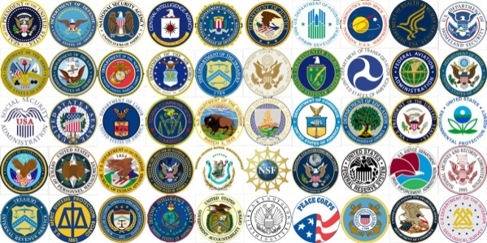

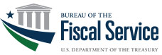









How Does a Paywall Solution Work for Government?
Government agencies can easily pay payment recipients
A Paywall integration solution offered by the Bureau of the Fiscal Service
Paywall Options
Payment recipients receive payment on their preferred option
NTAP
The Paywall concept supports an integrated solution for Government agencies to facilitate payment recipient preferences that also meet Strategic and Tactical goals of the Bureau of the Fiscal Service.
The payment networks above are for illustrative purposes only.

Slide 17
NTAP Potential Uses
Other Law Enforcement agencies
Disaster situations - - FEMA
Tax Refunds
Younger demographic payments - - Education
Others?

Slide 18

ONLINE BILL
PAYMENT
Convenient, Simple, Secure
Notes:
Our next pillar is Online Bill Presentment and Payment.
Through online bill presentment, agencies will be able to send bills directly to a payer’s bank account or email address. Payers may then choose to pay the bill directly from their bank accounts by using their bank’s website. We will be exploring online bill presentment more next year.
Online bill payment is a convenient tool to pay bills via ACH credit through a bank’s website. From the convenience of their home, or wherever they are, and from the same trusted bank platform they make other payments, customers can make a payment to the government and don’t have to provide their bank account or other personal information.

Slide 19

Online Bill Payment
ONLINE BILL PAYMENT, also referred to as Electronic Bill Payment, allows people to receive their bills, and pay them, through electronic means, like their online banking utility.
10 Agencies
49 Cash Flows
Collections totaling over $200M as of March 2016

Slide 20
Online Bill Payment (OLBP) Overview
OLBP is a convenient tool to pay bills via ACH credit by logging into a bank’s website or third party bill payment
One exception is sole proprietorships where the business owner uses their personal checking account to pay bills.
Each participating agency must be established as a “biller” in the network, with a unique biller profile
The Fiscal Service Credit Gateway program area walks interested agencies through the setup process
Billers in this context are Federal agencies with consumer customers
OLBP is only available to individuals with consumer bank accounts
OLBP is currently comprised of financial institutions and payment providers that share a common database of participating billers
20
Notes:
20

Slide 21
OLBP Benefits
Cost Effective
Most banks do not charge a fee for using online bill payment
Reduced Risk
Checks account for ~ 69% of nationwide payment fraud
ACH credit is less than 7%
Enhanced Customer Privacy
Customer Convenience
Customer Control
Faster Collection
ACH lowest cost payment option for the federal government
Customers don’t have to provide bank account information to the federal government
Online payments in lieu of writing and mailing checks
Ability to control the timing and amount of payments
Most bank OLBP websites offer the ability to schedule payments
Agencies receive collections sooner as ACH eliminates the clearing and settlement delay associated with the mail and processing of paper checks
21
Notes:
What Are The Benefits Of OLBP?
Less costly (to consumer & federal gov’t)
Most banks do not charge their customers a fee for using their online bill payment websites
ACH is the lowest cost payment option for the federal government
Less risk (ACH credit vs. check)
Checks account for ~ 69% of nationwide payment fraud
ACH credit is less than 7%
Enhanced Customer Privacy
Customers don’t have to provide their bank account information to the federal government
Customer Convenience
Consumers prefer online payments to writing and mailing checks
Customer Control
Consumers like the ability to control the timing and amount of their payments
Most bank OLBP websites offer the ability to schedule payments
Faster collection
Agencies receive their collections sooner because ACH eliminates the clearing and settlement delay associated with the mail and processing of paper checks
21

Slide 22
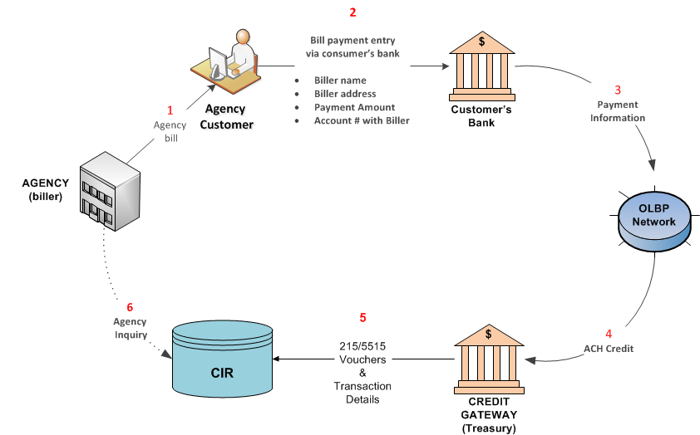
OLBP Process Flow

Slide 23
Four Steps to begin OLBP
Establish access to the CIR for deposit reporting
CIR setup: 1-800-346-5465
Setup Credit Gateway account for ACH processing
*2-5 business days
Setup Biller Profile
*10-15 business days
Communicate OLBP option to agency customers
23
Notes:
23

Slide 24

MOBILE PROGRAM
Convenient, Simple, Secure
Notes:
With the advent of mobile technologies and the ubiquitous nature of smartphones – statistics commonly say you’ll notice your phone is missing much quicker than you will your wallet, we are excited to talk more about our mobile program.

Slide 25

Mobile Program: On-the-Go Collections
THE MOBILE PROGRAM is a growing suite of simple, secure and convenient collections solutions designed to meet the needs of customers and agencies through mobile devices
Product for Agency-Use
Mobile Check Capture
Mobile Point-of-Sale
Product for Public Use
Public App

Slide 26
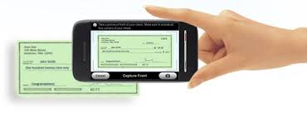
Mobile Check Capture
MOBILE CHECK CAPTURE provides government agencies with a convenient, simple and secure way to electronically collect and deposit checks in the field
What are its BENEFITS to Agencies?
Eliminates lost and stolen checks
Reduces exposure of citizen PII
Reduces exception processing
Reduces handling costs and float
Speeds time from point of collection to Treasury
Removes friction in data entry process
What are its BENEFITS to Customers?
Limits exposure of sensitive information
Improved customer service

Slide 27
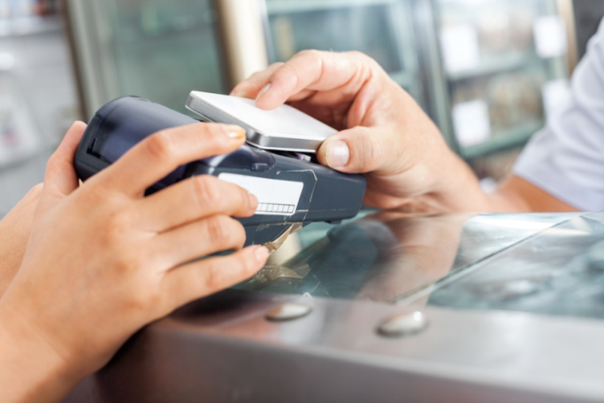
Mobile Point-of-Sale (mPOS)
MOBILE POINT-OF-SALE provides government
agencies with a convenient, simple and secure way to accept card transactions at the point of collection
What are its BENEFITS to Agencies?
Convert a mobile device into a POS terminal
Accepts all major credit cards, contactless and more
Enable employees to focus on mission-critical tasks, not collections processing
Speed time from point of collection to Treasury
What are its BENEFITS to Customers?
Improved customer service, as the POS is brought directly to the customer
Security and Choice in payments

Slide 28
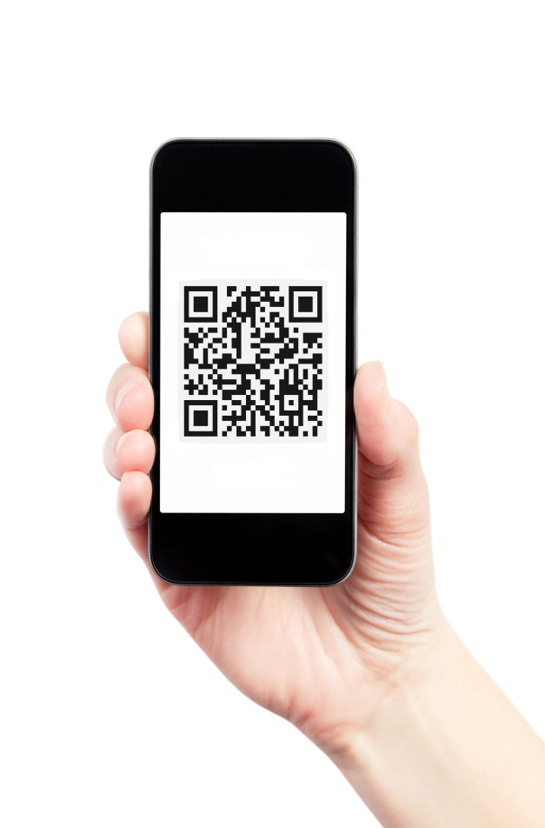
The Public App: Digital Receipt
THE PUBLIC APP allows agencies to easily create a publicly-available mobile application designed to enable collections and provide a digital receipt for their customers
What are its BENEFITS to Agencies?
Develop an agency-branded mobile app presence with no development resources or IT infrastructure required
Create remittance forms tailored to suit agency needs
Users can make payments anytime, anywhere with ACH, Card, or Digital Wallet
Enable employees to focus on mission-critical work/line-busting
Bringing best practices from the corporate world to the government sector
What are its BENEFITS to Customers?
Improved customer experience and faster, “on-to-go” service
Digital proof-of-payment in the form of a QR code receipt
Convenient, secure choices in payments

Slide 29
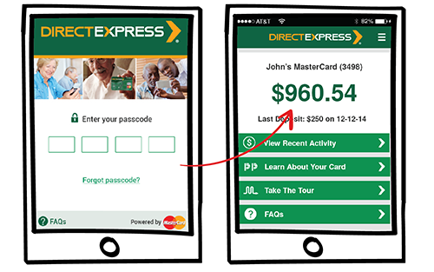
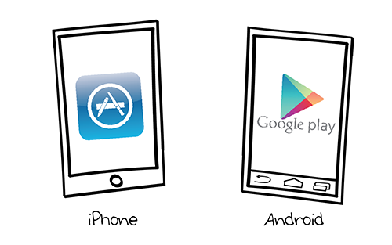
Direct Express® Opportunities
Mobile Application
Provides cardholders with many self service options to reduce customer inquiries to vendor and benefit agencies
Check card balance
View transactions made within 90 days
Deposit verification
ATM finder, including locations of Direct Express® surcharge free ATMs
Access to PayPerks, a program that helps cardholders understand how to use their prepaid card and improve their financial literacy
What’s Ahead?
Samsung Pay, Apple Pay - - digital wallet opportunities exist but are heavily determined by our cardholder demographics
Notes:
In August 2015, MasterCard® released a mobile application for Direct Express® that is available on iPhone and Android smartphones

Slide 30
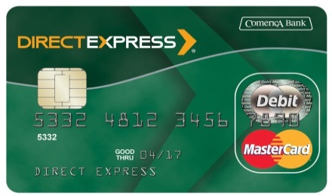
The President’s BuySecure Initiative
President Obama issued the BuySecure Executive Order in October of 2014 requiring the use of EMV, which will improve the government’s payment security and accelerate the transition to stronger security measures.
Collections
EMV impacts approximately 52 agencies and 3,200 terminals
Payments
Converting 4.5 million Direct Express® mag stripe cards to chip and pin cards
Unique challenges implementing EMV for large government-administered program consisting of primarily unbanked recipients
The first large implementation of EMV for prepaid cards in the industry
Notes:
Collections Progress: 1,804 deactivated and 1,107 new terminals deployed as of 9/4
For Payments, our Direct Express program is directly impacted by the Initiative.
Direct Express Program started in 2008 with Comerica Bank
Provides unbanked Federal recipients with a way to receive payments electronically without maintaining a bank account
Supports Treasury’s efforts that all payments be made electronically
4.5 million recipients currently receive payment by Direct Express®
Popular with cardholders
95% satisfaction rate
EMV Implementation
The Fiscal Service and Comerica Bank established an incremental implementation plan to ensure smooth transition of Direct Express cards to chip and pin enabled cards

Slide 31

Thank You
Adam Martin
Tamara Whitaker

